Slide 1
Learning from Incidents using Duty Holder Reviews
NZISM Palmerston North
Neil Mookerjee, Manager DHR
4 September, 2019

Slide 2
Today I will tell you about
1 Where do Duty Holder Reviews come from
2 What you need to know about Duty Holder Reviews
3 Lessons from Duty Holder Reviews

Slide 3
1
Where do Duty Holder
Reviews come from?

Slide 4
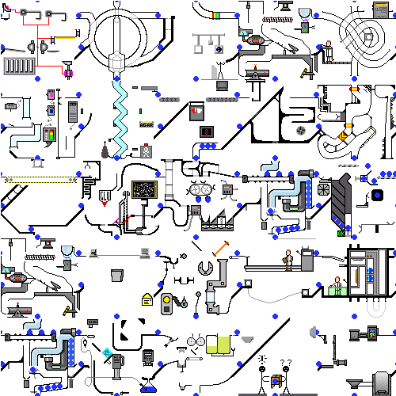

Slide 5
2
What you need to know
about Duty Holder Reviews

Slide 6
What you need to know
Done by the Duty Holder in co-operation with their employees identifying accident causes and then taking action to improve their health and safety systems to prevent further accidents
WorkSafe will oversee and support
The self-review provides assurance that lessons have been learned and improvements made

Slide 7
3
Lessons from
Duty Holder Reviews

Slide 8
Some Key Principles
Treating the incident as a catalyst for wider learning
Building long term relationships – through Engagement and Education
Using knowledge – internally and externally
Learning from Feedback

Slide 9
”Gave me a clearer understanding of the root cause of the incident.”
”By being impartial and asking Socratic questions.
They helped to uncover blind spots that we hadn’t thought of”
“Gave me a different perspective and raised awareness of potential issues”
“I anticipated the process to be more bureaucratic, but a very pragmatic and educational approach was taken”

Slide 10
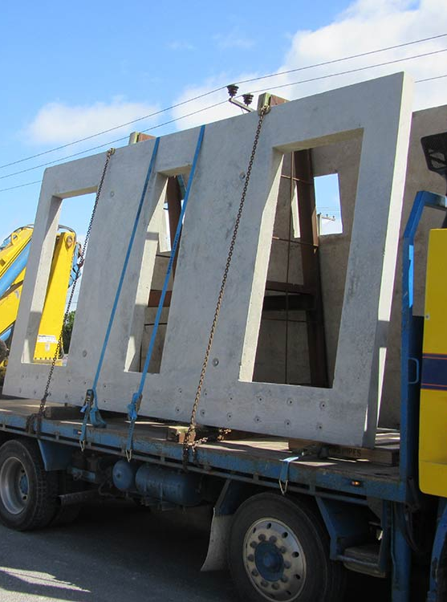
Case Study
SCENE HELD. Location xx Sales St, Auckland CBD
Concrete panel fell off truck and caught edge of drivers arm.
He was releasing panel.
Ambulance called, panel has gone onto road. Driver works for ABC Limited

Slide 11
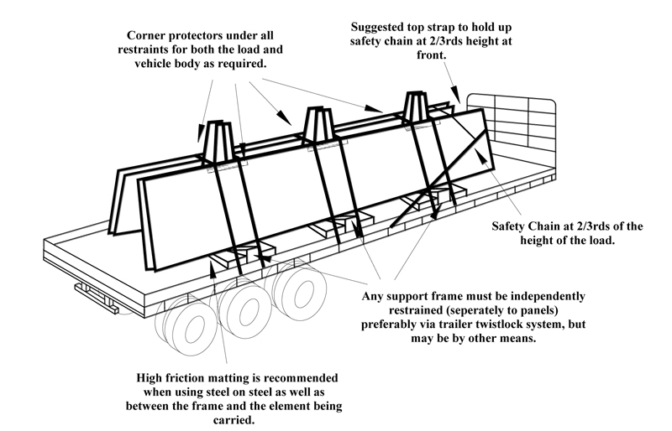
Case Study
SCENE HELD. Location xx Sales St, Auckland CBD
Upstream and Downstream
Overlapping duties
Managing total risk
Hierarchy of Controls

Slide 12
Today I told you about
1 Where do Duty Holder Reviews come from
2 What you need to know about Duty Holder Reviews
3 Lessons from Duty Holder Reviews
Over to you …

